Slide 1
SMART LAPTOP BUYING ASSISTANT
Machine Learning-Based Laptop Price Prediction, Specification Evaluation and Usage Recommendation System
Presented By: 2403064 - Akanksha Salunkhe
2553006 - Diksha Suryavanshi
2553009 - Manali Sawant
2553014 - Pranoti Bauchkar
Department: Computer Engineering
Academic Year: 2026–2027

Slide 2
Introduction
Selecting the right laptop is difficult due to numerous brands and hardware configurations.
Laptop prices vary according to processor, RAM, storage, graphics, and other specifications.
Buyers may struggle to identify laptops suitable for programming, gaming, or machine learning.
The proposed system uses machine learning to support informed laptop-buying decisions.
It provides price prediction, specification evaluation, and usage recommendations through a web application.
2

Slide 3
Problem Statement and Objectives
Problem Statement
Objectives
Predict laptop prices using a trained machine learning model.
Evaluate laptop specifications on a 5-point scale.
Recommend suitable and unsuitable usage categories.
Display detailed specifications and similar laptop options.
Provide a simple and user-friendly web interface.
Traditional laptop selection requires users to manually compare prices and technical specifications. This can be time-consuming and makes it difficult to determine whether a laptop suits a particular workload.
3

Slide 4
Proposed System
1 User Input
2 Input Processing
3 ML Prediction
User selects brand, processor, RAM, and operating system.
Flask validates the selected features and prepares the input data.
The trained model estimates the laptop price.
4 Specification Analysis
5 Usage Recommendations
6 Result Display
Displays the specification rating and buying verdict.
Identifies suitable and unsuitable workloads from specifications.
Shows summary, specifications, recommendations, and similar laptops.
User Input → Data Processing → ML Model → Price Prediction & Specification Analysis → Results & Recommendations
4

Slide 5
Dataset and Technologies Used
Dataset Description
Technologies Used
Laptop brands, prices, and technical specifications. Important attributes:
Language: Python
Web Framework: Flask
Machine Learning: scikit-learn and other training libraries
Data Processing: pandas and NumPy
Model Saving/Loading: joblib
Frontend: HTML and CSS
Environment: Visual Studio Code
Brand and laptop model
Processor and CPU
RAM capacity and type
Storage capacity and type
GPU (Graphics Processing Unit)
Display size and resolution
Operating system
Price and specification rating
5

Slide 6
AI Algorithms and Methodology
Methodology
Algorithms and Techniques
Data Collection: obtain the dataset
Data Preprocessing: handle missing values, clean data
Feature Selection: identify relevant inputs
Model Training: regression for price and spec rating
Model Evaluation: use appropriate metrics
Model Saving: store trained model
Web Integration: connect model to Flask
Result Generation: show predictions and recommendations
Regression: predicts laptop prices
XGBoost: specification-rating experiment
Rule-Based: RAM, processor, and GPU suggest suitable workloads
Evaluation Metrics
R² Score
Mean Absolute Error (MAE)
Root Mean Squared Error (RMSE)
6

Slide 7
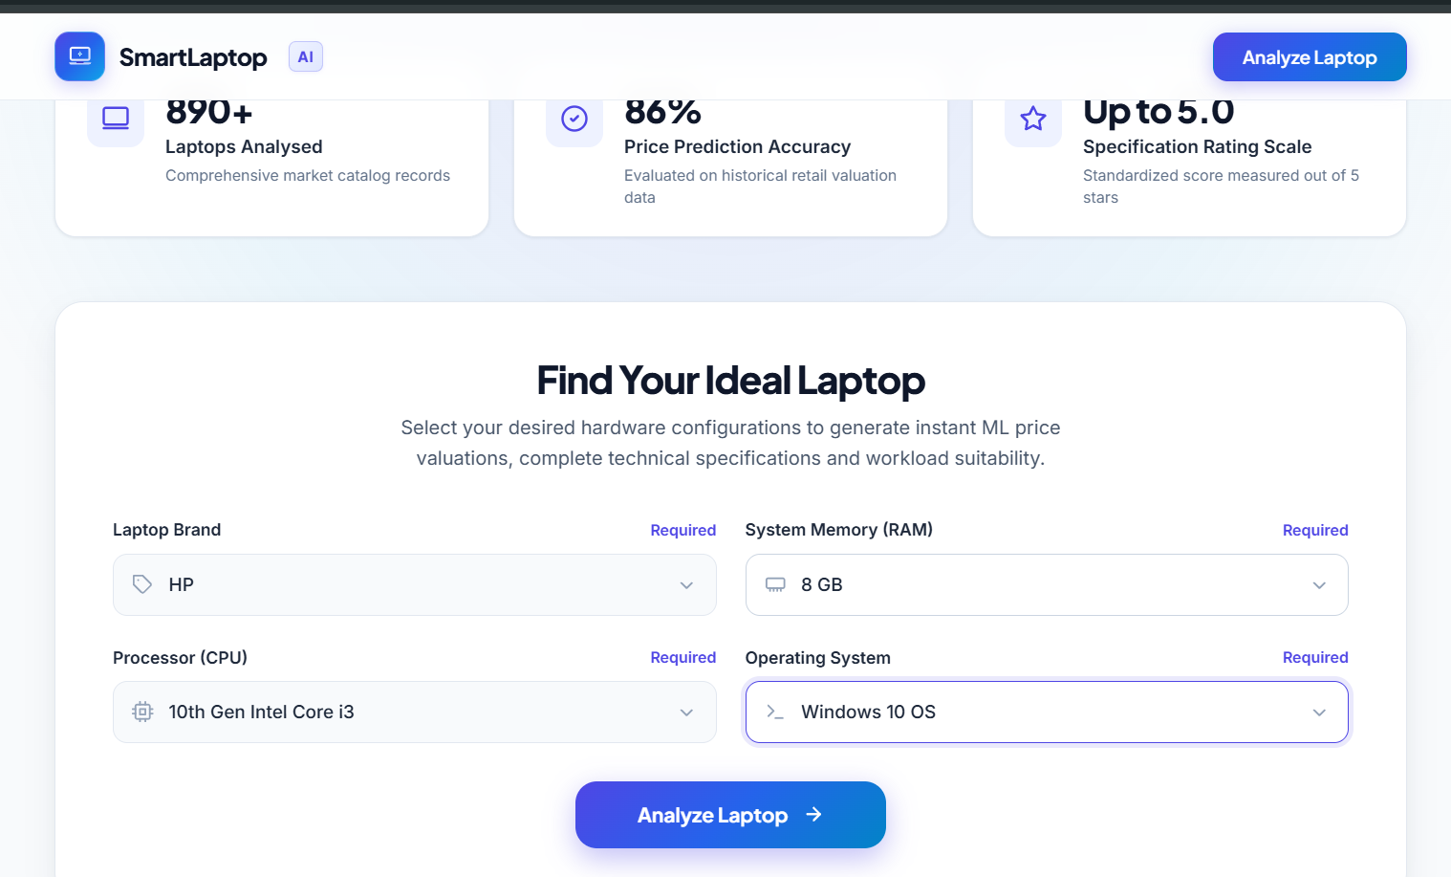
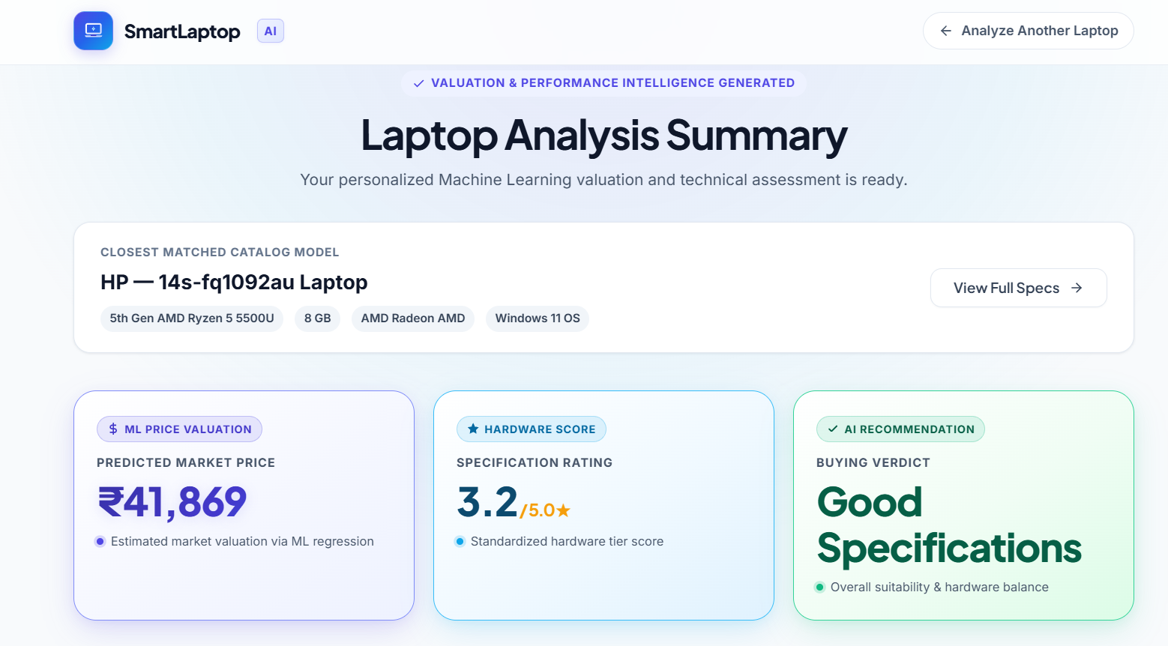
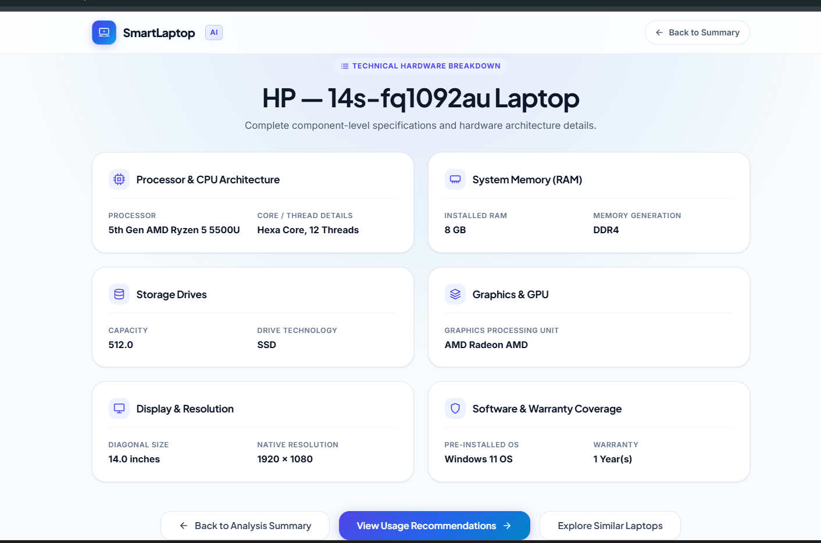
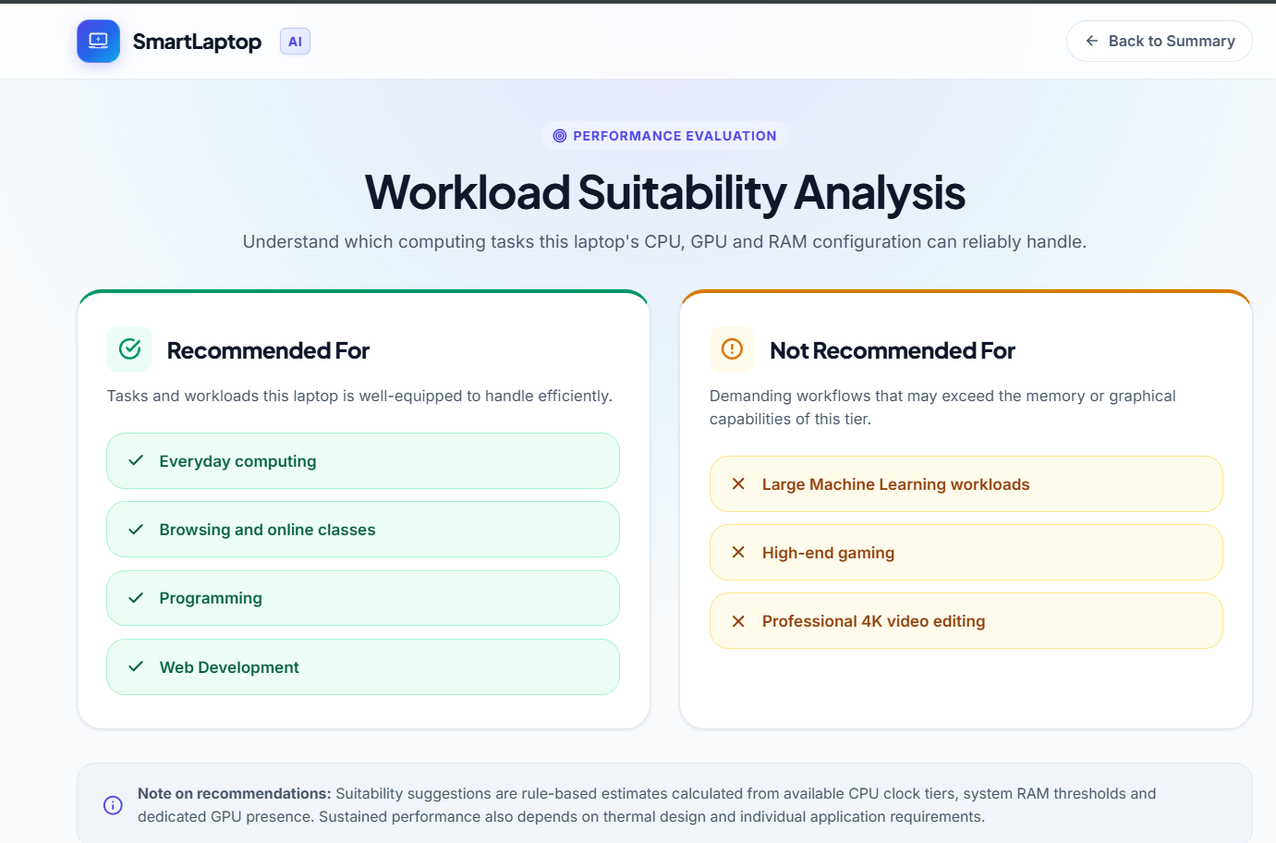
Implementation and Screenshots
A web application built with Python and Flask.
Screenshot:
Landing page
Screenshot:
Analysis summary
Landing Page: select laptop features
Analysis Summary: predicted price, rating, verdict
Laptop Specifications: processor, RAM, storage, GPU, display
Usage Recommendations: recommended and not recommended workloads
Similar Laptops: options for comparison
Screenshot:
Laptop specifications
Screenshot:
Recommendations
7

Slide 8
Results and Discussion
Price Prediction Model
0.8637
₹12,817.77
₹21,613.12
0.7969
R² Score
MAE
RMSE
XGBoost spec rating R²
Discussion
The price model explains a substantial portion of price variation in the evaluation data.
MAE and RMSE indicate the magnitude of prediction errors.
The system combines price estimation with specification analysis and usage recommendations.
Predictions depend on dataset quality and may differ from current market prices.
Verify the specification-rating result against the final deployed model before presenting.
8

Slide 9
Advantages, Future Scope and Conclusion
Advantages
Future Scope
Conclusion
Simplifies laptop comparison
Estimates prices using ML
Presents specs clearly
Workload-based recommendations
Combines ML with an interactive web app
Update dataset with current prices
Improve price and rating accuracy
Budget filtering and more configurations
Benchmark-based recommendations
Deploy online
Machine learning and web technologies can support laptop purchasing decisions, combining price prediction, specification evaluation, recommendations, and comparison in one application.
Further improvements: updated datasets, better model evaluation, and enhanced recommendation techniques.
9

